Slide 1
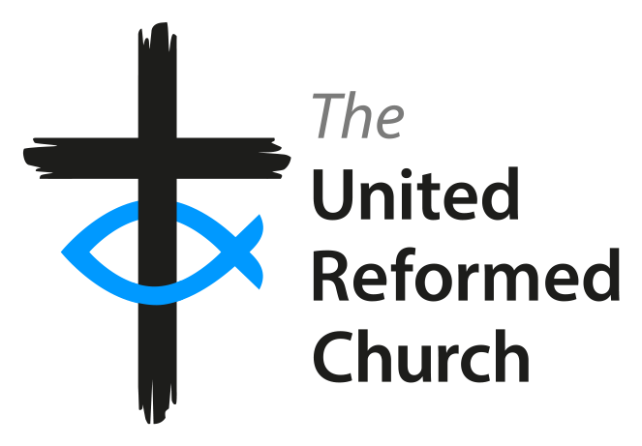
Steve Summers
CRCW Development Worker
URC Discipleship Team
Creating Change in Communities and the Church

Slide 2
‘Assembly acknowledges that in Church Related Community Workers, properly trained and properly [de]ployed, the Lord Jesus Christ is giving particular gifts for a particular ministry and is calling such individuals to exercise them in an office which is duly recognised
within His Church.’ URC General Assembly 1987
Creating Change in Communities and the Church

Slide 3
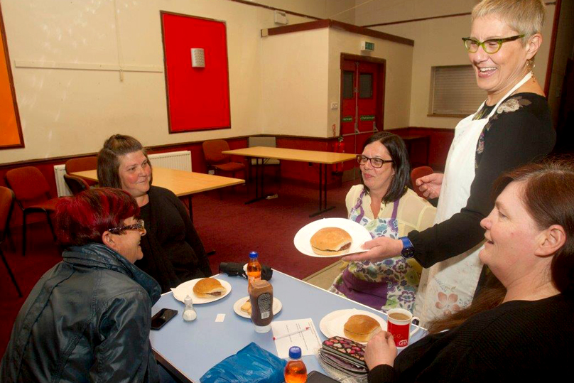
Community development work is concerned about bringing groups of people together to identify their assets and to collaborate on their own issues, hopes and opportunities.
A Church Related Community Worker (CRCW) is a community development worker who enables the Church to work within its local neighbourhood, rather than someone employed by the Church to work on its behalf or only with church members.
Creating Change in Communities and the Church

Slide 4
A CRCW will work in partnership with your local congregation, church members, elders and Minister of Word and Sacraments in order for you to become more present and engaged with your local neighbourhood, groups and community organisations.
Creating Change in Communities and the Church

Slide 5
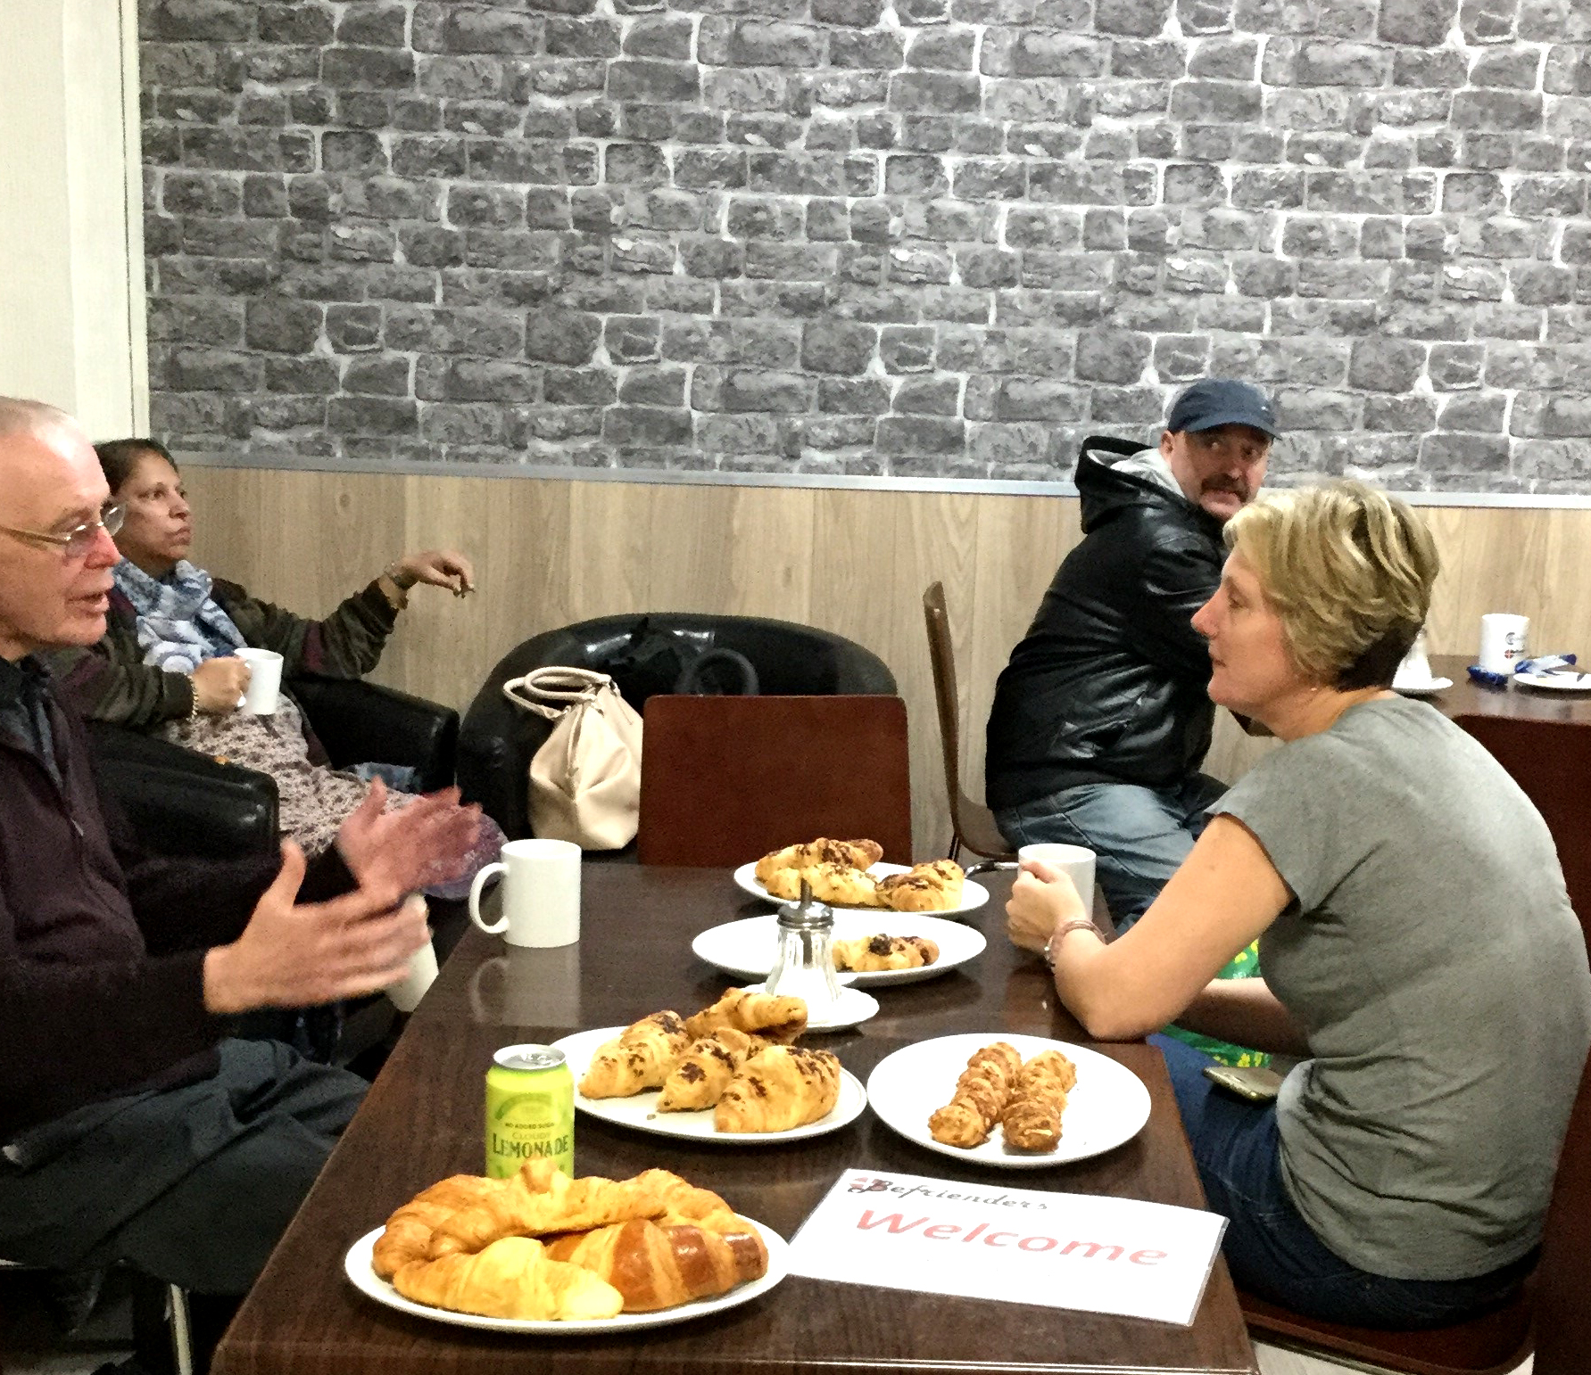
The context for community development is normally but not exclusively among people who are disadvantaged eg. by poverty, poor health, limited education and job opportunities and broken social networks. CRCWs work with a wide variety of groups including residents’ associations, credit unions, community groups, campaigning groups, housing associations, local authorities etc.
Many URC churches are already actively present and engaged in their local neighbourhoods.
Creating Change in Communities and the Church

Slide 6
CRCW ministry has already been amongst 62 Church and community settings, involving 47 different CRCWs.
Many more churches would like to have a CRCW ministry with them – how can you encourage members to consider whether God is calling them to become a CRCW?
Creating Change in Communities and the Church

Slide 7
Christian community workers with appropriate experience and qualifications are able to apply for a ‘Certificate of Eligibility’ to become a URC accredited Church Related Community Worker.
Creating Change in Communities and the Church

Slide 8
Thank you.
https://urc.org.uk/become-a-crcw
https://twitter.com/CRCWteam
@enablingchange
Facebook: Church related Community Work –CRCW
steve.summers@urc.org.uk
Tel. 0207 916 8653
Creating Change in Communities and the Church

